Slide 1
Scalable implementation of a distributed system model
TEAM 16
JAGADISH RAMAMURTHY
MUKESH ARAMBAKAM
CHAO CHEN
POOJA GANESH TEJE

Slide 2
PLATFORM
Comparison between AWS Lambda, Azure IoT, EC2 & Docker-based Implementation.
Cloud9 Implementation – EC2, IoT Core, IAM, SNS
Docker-based Implementation – NodeJS, Redis, Elastic & Logstash & Kibana

Slide 3
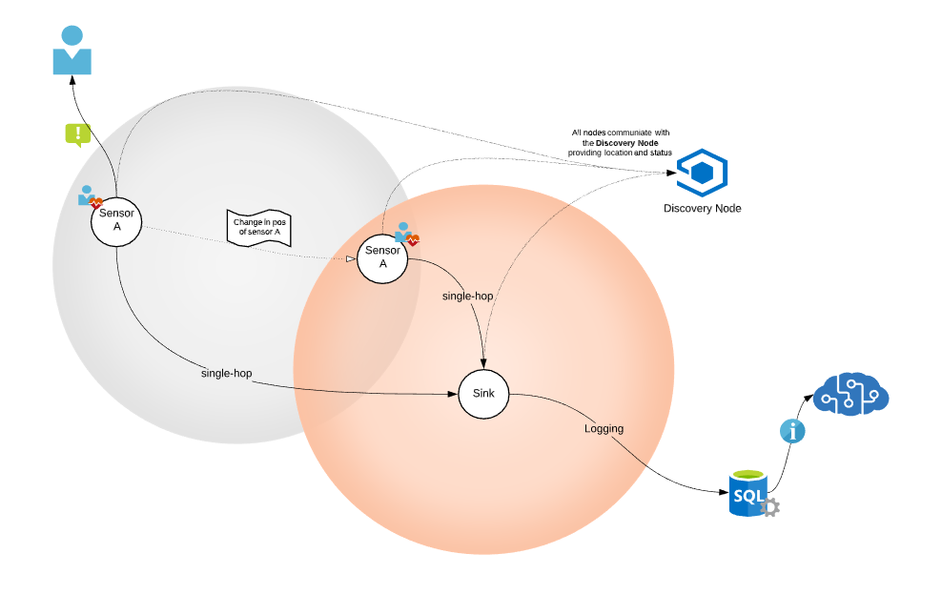
Network topology

Slide 4
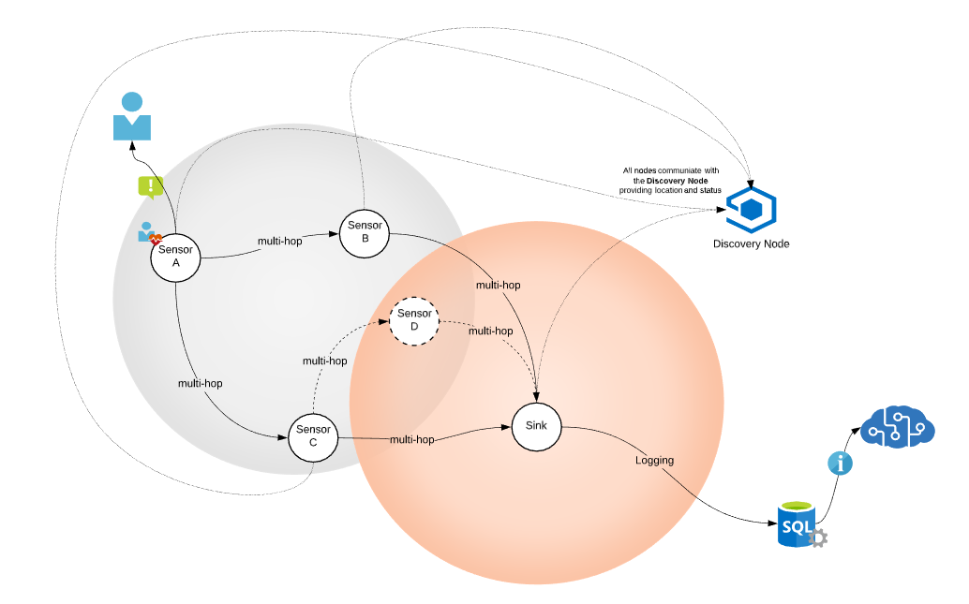
Network topology

Slide 5
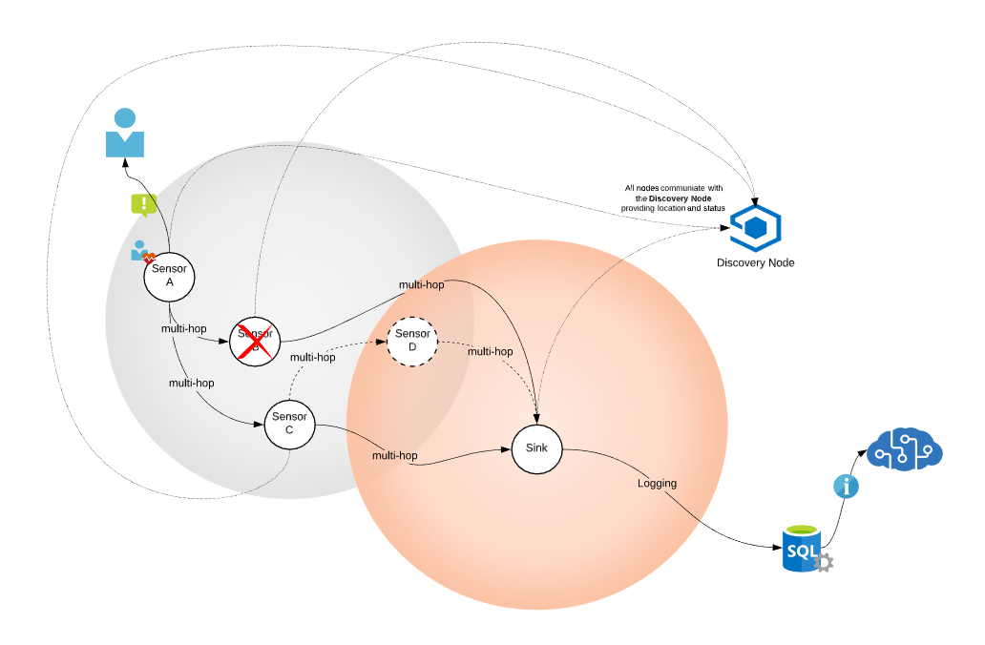
NETWORK TOPOLOGY

Slide 6
Key challenges – addressed, solved
Oscillation of Duty Cycle [Low Battery]
Dynamic change in location of sensors [representation of motion in human body]
Routing Algorithm for shortest path – Link State Protocol
Failover mechanism for data loss or deletion on node failure
Alert Notification – low battery, abnormal data detection
Event trigger to charge sensors, change states and duty cycle.

Slide 7
Future implementation
Oscillation of Duty Cycle [Abnormal data detection]
Node Power Optimization – Investigate & Implement multiple routing algorithms for shortest path.
Bellman Ford [Distance Vector Routing Protocol]
Have the sensor to self trigger the events for changing states and duty cycle avoiding unnecessary comms.
Setup Datastore, Pipeline and Machine Learning Algorithm

Slide 8
Thank you

